Slide 1

The Road to Canvas
Canvas LMS Implementation Project
July 2023
Presented by:
Aaron Hawke
Content Migration Manager
Debra Raca
Change and Transition Manager
Anwar BinUmer
LMS Functional Analyst
Notes:
Welcome to 'The Road to Canvas' a presentation delivered on behalf of the Canvas LMS Implementation Project

Slide 2

The Road to Canvas
This presentation will outline how we will support you on your road to Canvas.
Your journey will be broken into 5 key stages:
Awareness
Training
Reviewing
Preparing
Teaching (in Canvas)
Notes:
This presentation will outline how we can support you on your road to going live with Canvas.
There will be 5 key stages that take you from Awareness all the way to teaching with Canvas.

Slide 3
1. Awareness

Slide 4

Awareness
The following slides will give you some high-level information on the LMS migration, including:
An overview of the migration process
An LIC User Journey Map
The Unit Snapshot
Unit Snapshot Dates
Links to Support
Timelines
Notes:
The following slides provides high-level information on LMS Migration. This includes:
An overview of the migration process
An LIC User Journey Map
The Unit Snapshot
Unit Snapshot Dates
Links to Support
Timelines

Slide 5


Stages of Migration
STAGE 1: UNIT MASTER LIST (UML)
STAGE 2: QUALITY ASSURANCE (QA)
STAGE 3: READY TO TEACH (RTT)
Stages
This stage of the project ensures that the key data related to units to be migrated is captured and confirmed with the School
This stage of the project ensures that each unit is quality checked after the automated migration and before it is returned to the LIC for review
This stage of the project provides support to the LIC before the unit goes live on issues related to the migration of content and setting up their Canvas unit
Purpose
Notes:
There are three stages of in the migration process.
Stage 1 involves the Unit Master List. This involves staff populating a spreadsheet with the key data relating to units that will be migrated from LEO to Canvas.
Stage 2 requires LICs and NLICs to review the migrated units using a checklist.
Stage 3 supports staff with ensuring their unit and staff are ready to teach.

Slide 6











LIC User Journey
STAGES
AWARENESS
TRAINING
REVIEWING
PREPARING
TEACHING
Canvas Sandpit
Canvas Login
Canvas LTIs
Canvas Assignments
Canvas LTIs
Canvas People
Canvas Gradebook
Canvas Reporting & Analytics
CANVAS
Canvas RCE
Canvas UI
Canvas RCE
Unit Outline
Canvas RCE
Canvas Calendar
Canvas Discussion Boards
Canvas Announcements
Targeted emails from School and Faculty
Link to unit to review
Configure LTIs
KEY ACTIVITIES
Updates posted on Workplace and other forums
Canvas Essentials 2: “Set” QA Training
Update your Canvas unit
Enroll unit teaching staff
Deliver online and in-person classes using Canvas
Canvas Essentials 1 Training “Ready”
Mark your migrated unit as "Review Complete"
Canvas Essentials 3 Training: "Go" Learning and Teaching
FAQs and Workshops
Project FAQs
Face-to Face Training
QA Support Team
Face-to Face Training
Canvas Impact
SUPPORT
Canvas Training Modules
QA Resources in Migrated Unit
Canvas Training Modules
Canvas Help Desk
QA Resources in Migrated Unit
Learning Designers & Learning Technologists
Learning Designers & Learning Technologists
Notes:
The typical journey of a LIC in each stage can be found on this slide.
They start in the awareness area and receive communications informing them of steps that will take them through to completion.
As the LIC moves into training, they will receive support with using Canvas for the first time and how to complete the QA process. They will receive resources that will help build confidence.
The LIC will then review and sign off their migrated unit as 'ready to teach'. The preparation stage involves final steps to ensure Canvas can launch successfully before moving into teaching. There will be ongoing support even after the transfer.

Slide 7
What is the Snapshot?
Put simply this refers to the timing of a copy we will be taking of the entire LEO site.
To ensure minimal disruption to teaching and learning at ACU, we will be taking two direct copies of LEO and moving them into a test server. This will be the LMS content we will move from LEO to Canvas. There will be no disruption to LEO at all, teaching activities will proceed as usual.
Any changes that you make to your LEO unit after these dates will also need to be updated in Canvas.
Notes:
The snapshot date is an important date to be aware of. The snapshot is a copy of the LEO site that will be transferred over to Canvas. There isn't a live link between LEO and Canvas and therefore anything created in LEO after the snapshot date will need to be recreated in Canvas by staff. There will not be any disruption to LEO and staff can continue to use it. However, it would be a good idea to save any major changes for Canvas.

Slide 8

Snapshot Dates
The snapshots occurred on the following dates:
Snapshot 1: Postgraduate
Sunday April 9th 2023
Snapshot 2: Undergraduate
Sunday May 28th 2023
Notes:
The postgraduate snapshot took place on April 9th 2023 and the Undergraduate snapshot is happening on Sunday May 28th 2023.

Slide 9
2. Training & Support

Slide 10



Training Timeline
POSTGRADUATE
JAN | FEB | MAR | APR | MAY | JUN | JUL | AUG | SEP | OCT | NOV | DEC | JAN | FEB | MAR | APR | MAY | JUN | JULY
UNDERGRADUATE SEM 1 (STAGE 2)
UNDERGRADUATE SEM 2
Canvas Intro
POSTGRADUATE
UNDERGRADUATE SEM 2
UNDERGRADUATE SEM 1
QA Training
POSTGRADUATE
UNDERGRADUATE SEM 1
POSTGRADUATE SEM 2
Ready to Teach
2023
2024
POSTGRADUATE TRAINING OPENS: MARCH 13
UNDERGRADUATE TRAINING OPENS: SEPT. 4
SEMESTER 1 GO LIVE: FEB. 12
WINTER TERM GO LIVE: MAY 20
POSTGRADUATE GO LIVE: JULY 17
SUMMER TERM GO LIVE: NOV.20
SEMESTER 2 GO LIVE: JULY 15
Notes:
The slide above shows the projected timeline of events associated with training.

Slide 11

Training for Canvas
The training for Canvas is in 3 stages:
Ready
Set
Go
“Ready” is a Canvas basics course that will help you familiarise yourself with Canvas.
“Set” is a course designed to help you prepare for reviewing your Canvas course after Quality Assurance.
“Go” is a course designed to get you ready to teach in Canvas.
Notes:
The training for LICs and NLICs in Canvas involves three stages.
Canvas Essentials 1: Get Ready – is a showcase of Canvas basics and access to the system and a sandbox
Canvas Essentials 2: Get Set – is a walkthrough of the QA process.
Canvas Essentials 3: Go – is learning and teaching with Canvas.

Slide 12
Training: Essentials 1
Cohort | Complete by
Postgraduate Sem. 2 2023 | Apr 23
Postgraduate Sem. 1 2024 | Nov 23
Undergraduate Sem. 1 2024 (inc. Summer Term) | Nov 23
Undergraduate Sem. 2 2024 (inc. Winter Term) | Apr 24
Cohort | Complete by
Postgraduate Sem. 2 2023 | May 23
Postgraduate Sem. 1 2024 | Jan 24
Undergraduate Sem. 1 2024 (inc. Summer Term) | Jan 24
Undergraduate Sem. 2 2024 (inc. Winter Term) | May 23
Cohort | Complete by
Postgraduate Sem. 2 2023 | Jun 23
Postgraduate Sem. 1 2024 | Feb 24
Undergraduate Sem. 1 2024 (inc. Summer Term) | Feb 24
Undergraduate Sem. 2 2024 (inc. Winter Term) | Jun 23
Notes:
Here are the guide dates for completion of training in time for each of the launches.
Training links:
Canvas Training Booking System (live versions): https://outlook.office365.com/owa/calendar/ACUCanvasTraining@myacu.onmicrosoft.com/bookings/
Canvas Essentials 1: Ready... (Canvas basics) self-paced: https://canvas.acu.edu.au/enroll/7AP6F8
Canvas Essentials 2: Set... (QA Process) self-paced: https://canvas.acu.edu.au/enroll/B6XB9Y
Canvas Essentials 3: Go... (Learning and Teaching with Canvas) self-paced: https://canvas.acu.edu.au/enroll/73BJRC

Slide 13
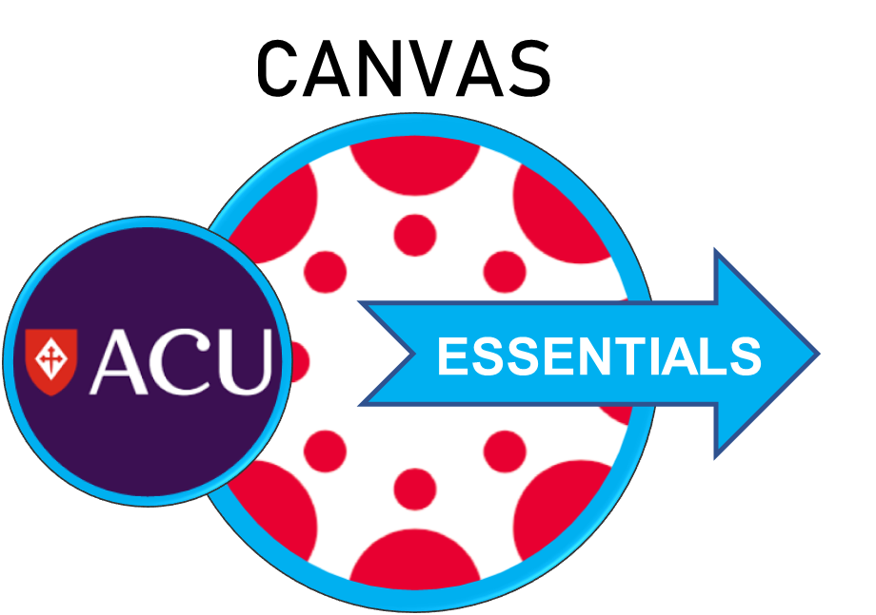
Training: Essentials 2
Cohort | Due Date
Postgraduate Sem. 2 2023 | Apr 23
Postgraduate Sem. 1 2024 | Nov 23
Undergraduate Sem. 1 2024 (inc. Summer Term) | Nov 23
Undergraduate Sem. 2 2024 (inc. Winter Term) | Apr 24
Cohort | Due Date
Postgraduate Sem. 2 2023 | May 23
Postgraduate Sem. 1 2024 | Jan 24
Undergraduate Sem. 1 2024 (inc. Summer Term) | Jan 24
Undergraduate Sem. 2 2024 (inc. Winter Term) | May 23
Cohort | Due Date
Postgraduate Sem. 2 2023 | July 23
Postgraduate Sem. 1 2024 | Feb 24
Undergraduate Sem. 1 2024 (inc. Summer Term) | Feb 24
Undergraduate Sem. 2 2024 (inc. Winter Term) | Jul 23
Cohort | Due Date
Postgraduate Sem. 2 2023 | Jun 23
Postgraduate Sem. 1 2024 | Feb 24
Undergraduate Sem. 1 2024 (inc. Summer Term) | Feb 24
Undergraduate Sem. 2 2024 (inc. Winter Term) | Jun 23
Notes:
For wider staff, the important parts of Canvas Essentials 1 and 3 for LICs will be combined into one training session – Canvas Essentials.
There will be a version for academic staff and a version for professional staff to meet needs.

Slide 14
Canvas Training Quick Links
LIC/NLIC pathway:
Canvas Essentials 1 (showcase of Canvas):
https://canvas.acu.edu.au/enroll/7AP6F8
Canvas Essentials 2 (QA process walkthrough – best to complete when receiving migrated units):
https://canvas.acu.edu.au/enroll/B6XB9Y
Canvas Essentials 3 (learning and teaching with Canvas):
https://canvas.acu.edu.au/enroll/73BJR
Other Teaching Staff Pathway:
https://canvas.acu.edu.au/enroll/844PET
‘Live delivery’ versions of some of these services are available at this link:
https://outlook.office365.com/owa/calendar/ACUCanvasTraining@myacu.onmicrosoft.com/bookings/
LMS Project Training Website:
Two-minute tutorial videos for staff and training updates are available HERE.
Other training options will be made available as we start using Canvas.

Slide 15

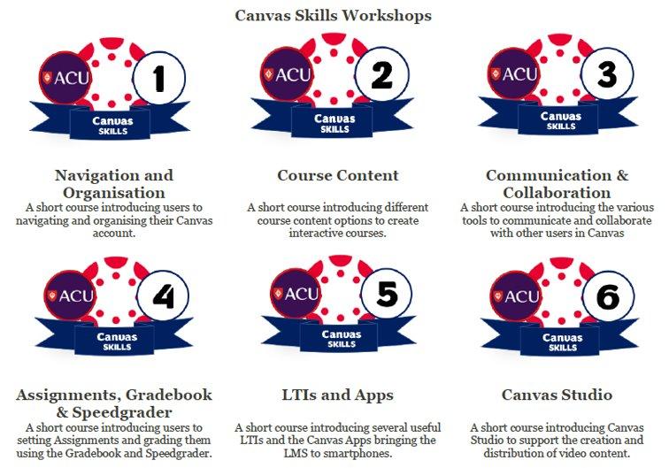

Supplementary Training
School Consultations:
Fortnightly FAQ and Drop-Ins:
Notes:
To compliment the Essentials Canvas package, there are wider Canvas Skills self-paced courses. These will be hands-on training sessions that staff can choose to enrol in over the course of the year.
There will be a fortnightly drop-in sessions with topics around common queries that have come up through Service Central and Ask ACU.
There will also be a consultation with each school provide training to meet their specific requirements.

Slide 16
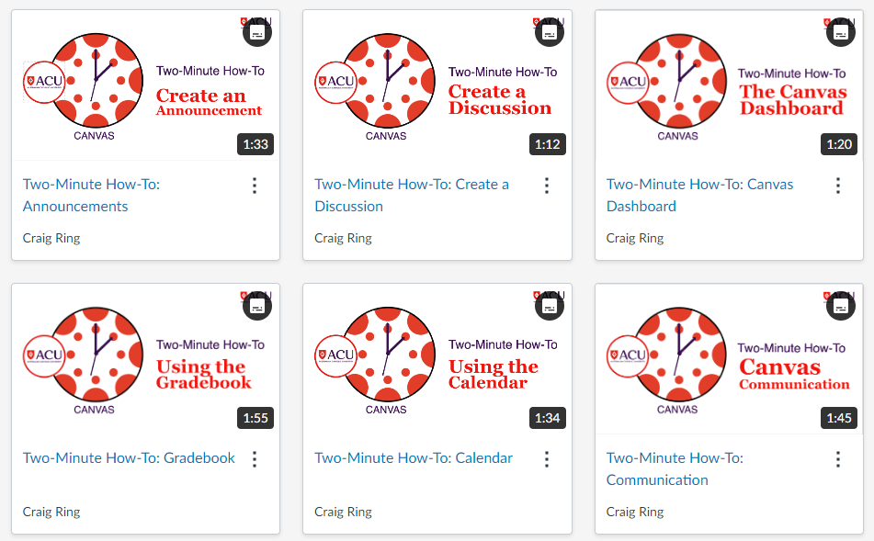

Two-Minute How-To Tutorials:
Notes:
We have a series of videos called 'Two-Minute How-To' videos. These are short tutorials on how to use the basic functions of features in Canvas. There will also be student-facing versions of these videos at launch.

Slide 17
How to Get Support
Support Required
Issues specific to your unit.
Support with the QA process and content migration.
Support Required
General Canvas Support
Learning about Canvas features
Support with navigating Canvas
Support from QA Team
Discussion forum - This is targeted support that is available within your unit – (response in under 48 hours)
Virtual QA Drop-in Session - This is a weekly virtual session held by the QA team where you can book time to discuss general issues, or issues related to your unit (Weekly)
Training
Canvas Essentials
Canvas Skills
Canvas FAQ Drop-In
Two-Minute How-To Videos and Canvas Guides

Slide 18
Where Can I Get More Information?
We will be using the following channels to provide updates on the project:
Workplace Posts
Teaching Matters Newsletter
Canvas Consultation Group
Canvas Project Website (Canvas Implementation Project Site)
You can contact the project directly via the Canvas Project mailbox:
LMSProject@acu.edu.au
Notes:
We are increasing out communications as we move towards our go-live date. Look out for comms in Workplace, the Teaching Matters Newsletter, through consultation groups and the Canvas Implementation Project website.
You can contact the project team using LMSProject@acu.edu.au.

Slide 19
Resources
Canvas App for Teaching Staff Video Tutorial
Canvas App for Students Video Tutorial
LEO and Canvas Tool Comparison (pdf)
ACU Canvas Glossary (pdf)
Canvas Implementation Project website
Canvas Implementation Project FAQs
Canvas LMS Resources on Instructure website (Instructor guides)
Canvas Training & Support Resources website

Slide 20
Canvas Experience Guide
Complete Canvas Experience Guide.pdf
Part 1: ACU Canvas Model.pdf
Part 2: Course Setup Guide.pdf​
Part 2A: Checklist.pdf​
Part 3: Support.pdf​

Slide 21
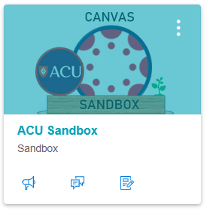
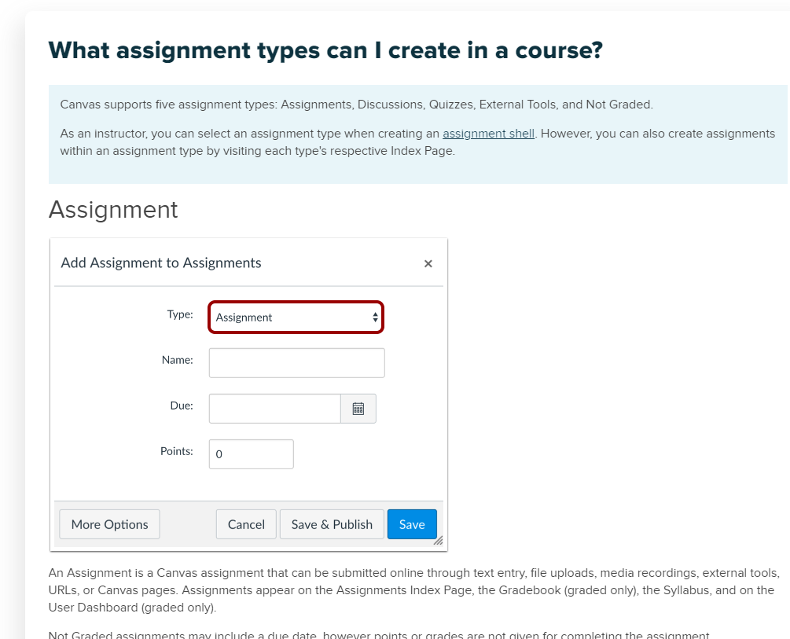
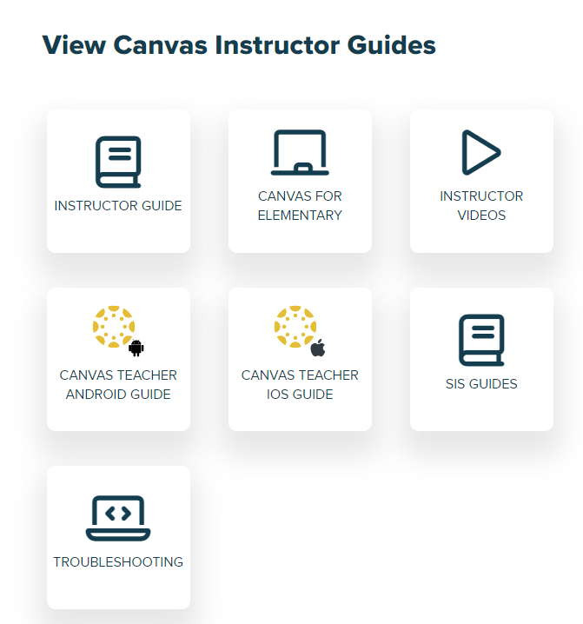
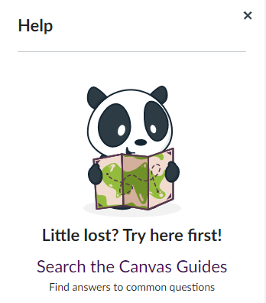

Notes:
Within Canvas there is a help menu with a link to the Canvas Instructor Guides. These are step-by-step instruction manuals with videos and images for staff to explore and work through in their ACU Sandbox.

Slide 22
3. Reviewing

Slide 23

Receiving Your Migrated Unit: What to Expect
When you receive your Canvas unit, it will have passed a Quality Assurance (QA) check by the project team.
The Project Team will include instructions on what to do next.
These instructions will be contained within the Canvas unit in a Discussion Board post.
You can reply in the Discussion Board if you need assistance and the team will reply to you within 48 hours. The team will either reply to you in Canvas or book a time to speak with you over Teams.

Slide 24
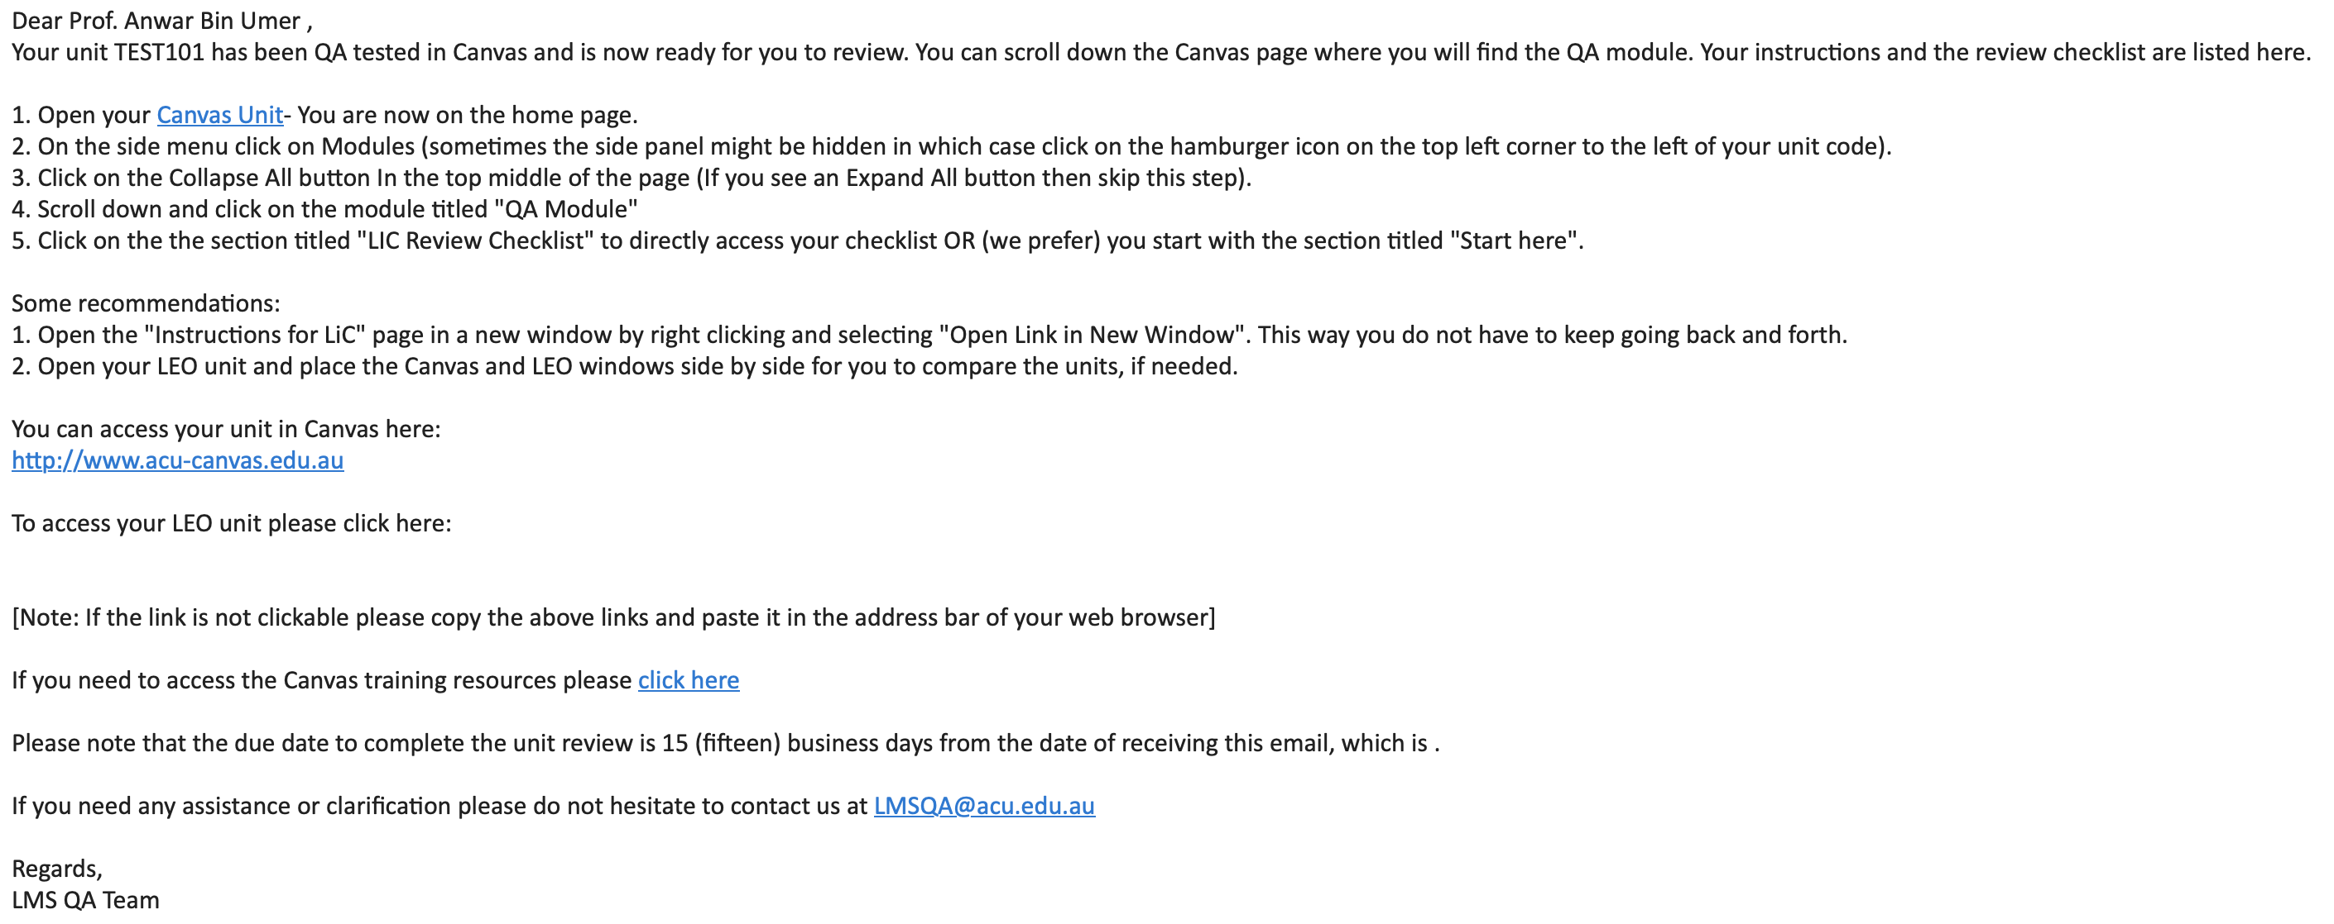
Email received
The process will begin when you receive an email with a link to access your unit.
There will be an individual email per unit.

Slide 25
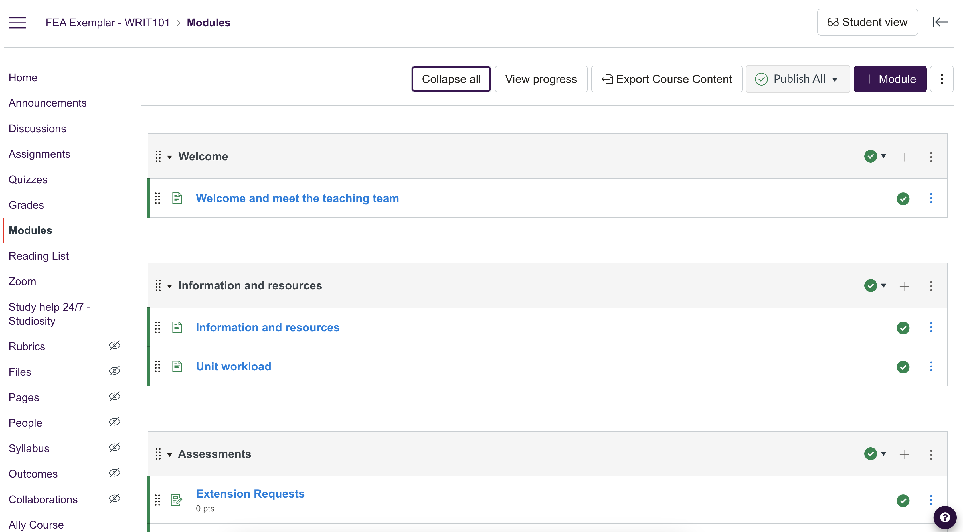
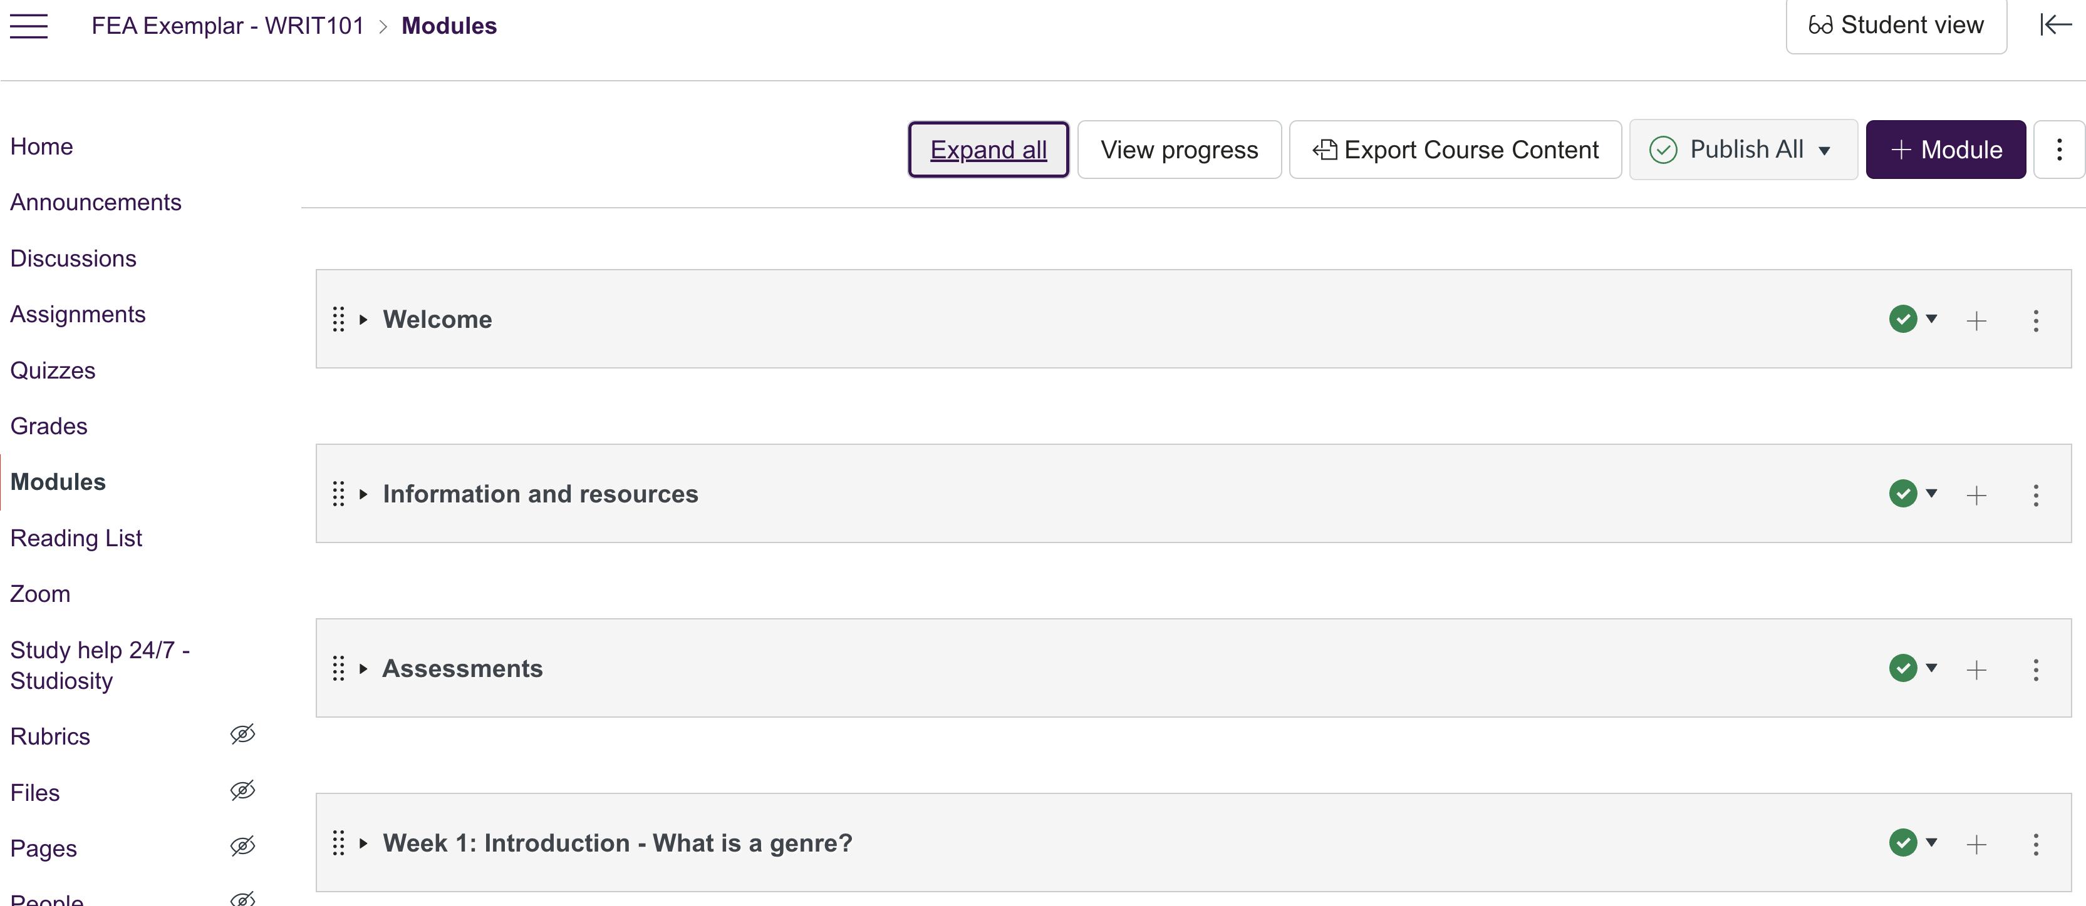
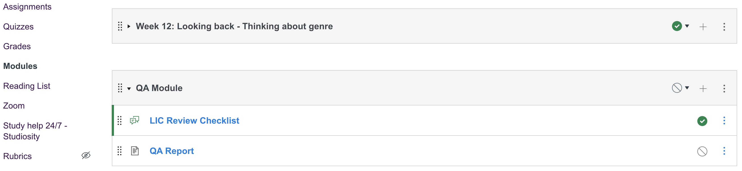
Receiving Your Migrated Unit: What to Expect (cont.)
Below are some screenshots of Canvas Modules and the QA Module.
Canvas Modules : The email link should take you to the modules of your Canvas unit.
QA Module: The QA Module located at the bottom of the page contains the LIC Review Checklist and the QA Report

Slide 26
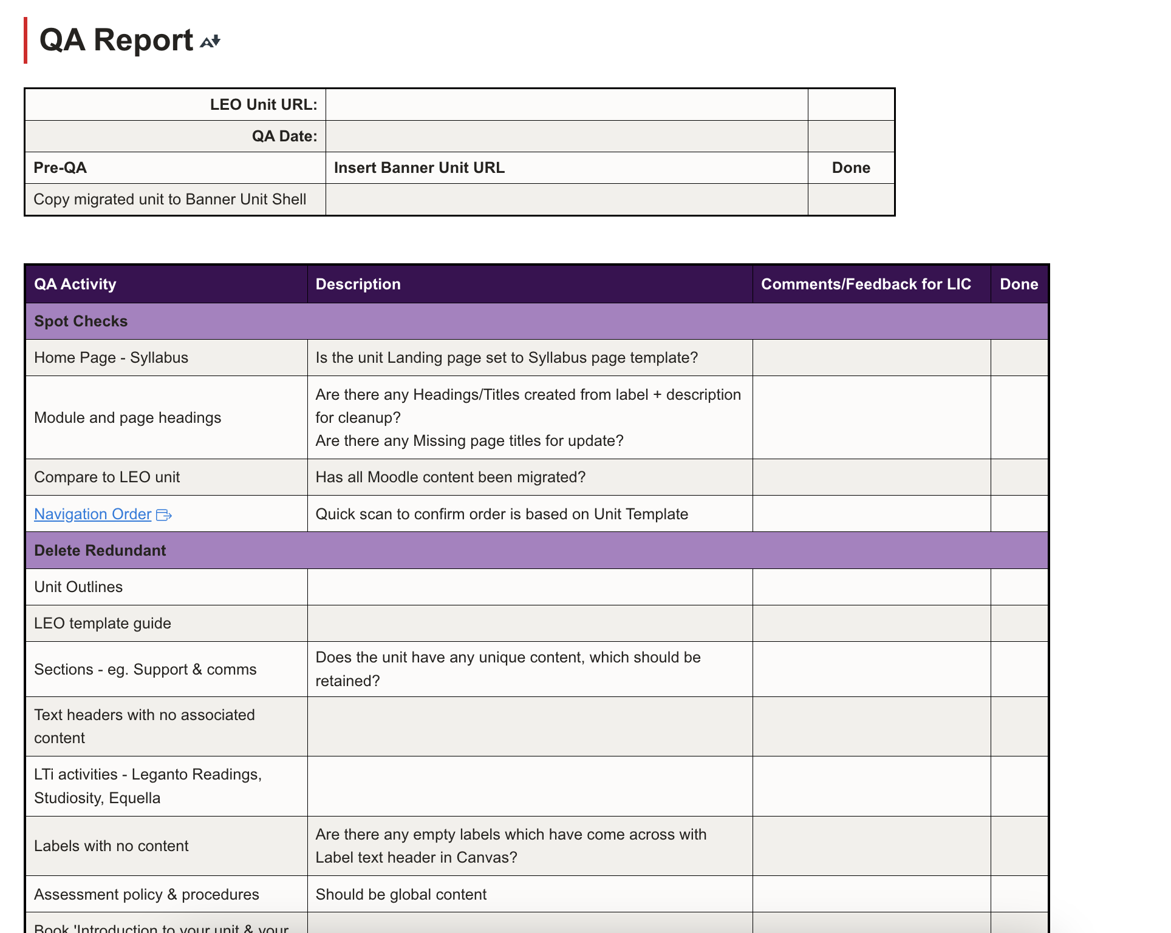
Receiving Your Migrated Unit: What to Expect (cont.)
Below is a screenshot of the QA Report.
QA Report: This is a report that outlines all of the checks conducted by the QA Testers

Slide 27
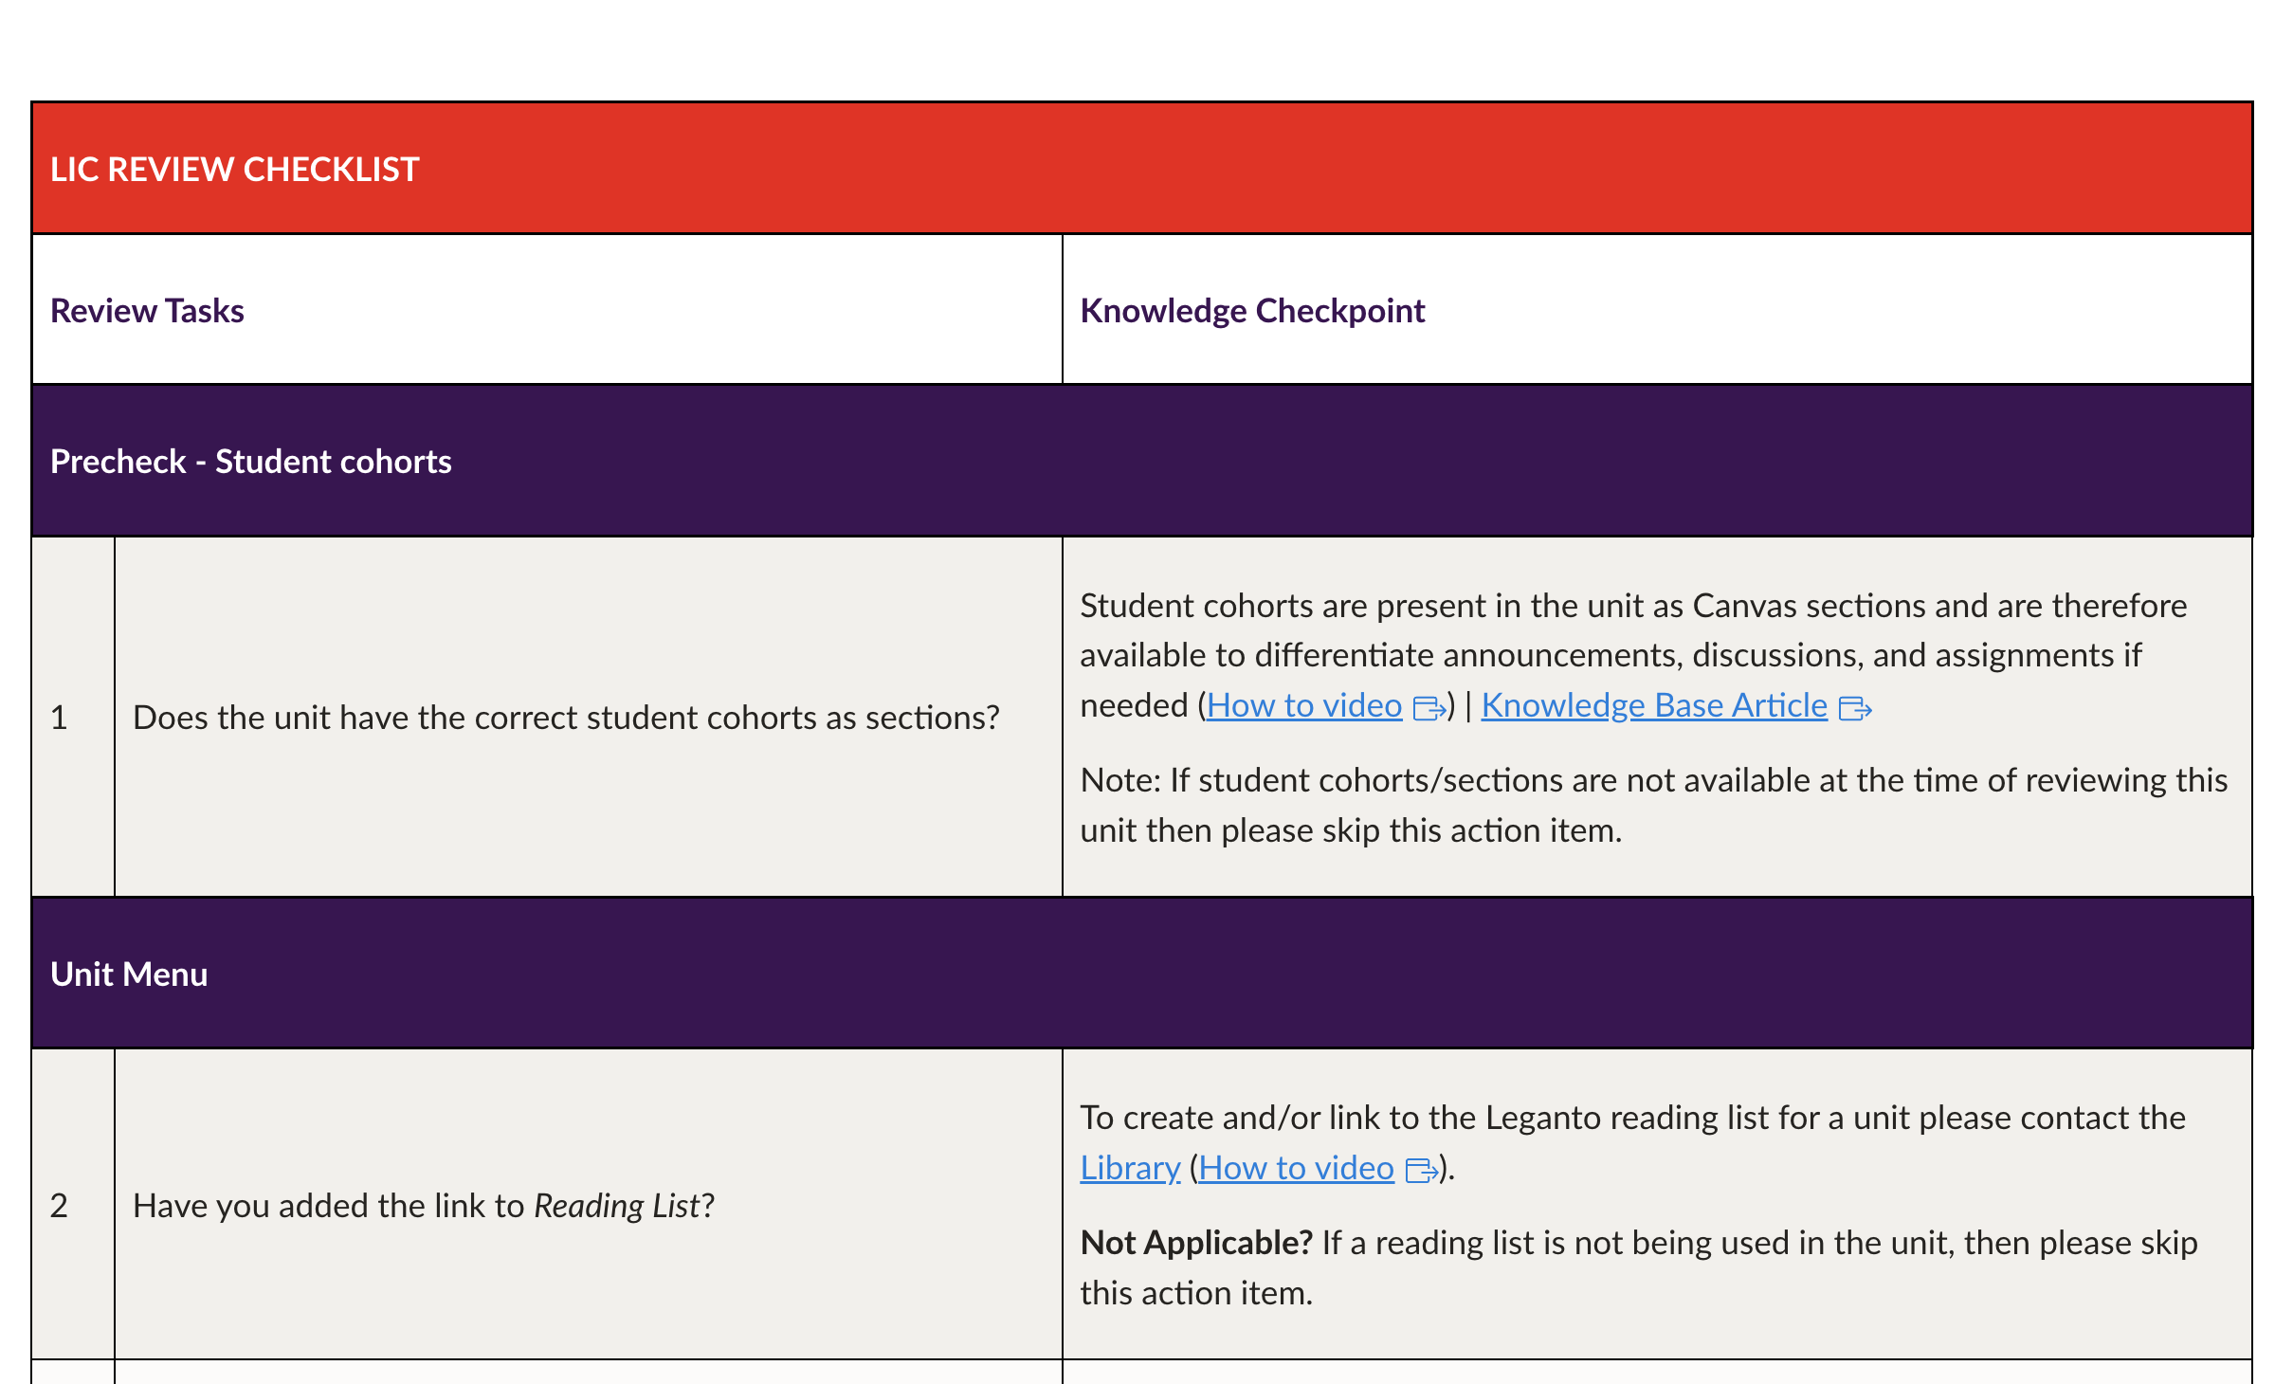
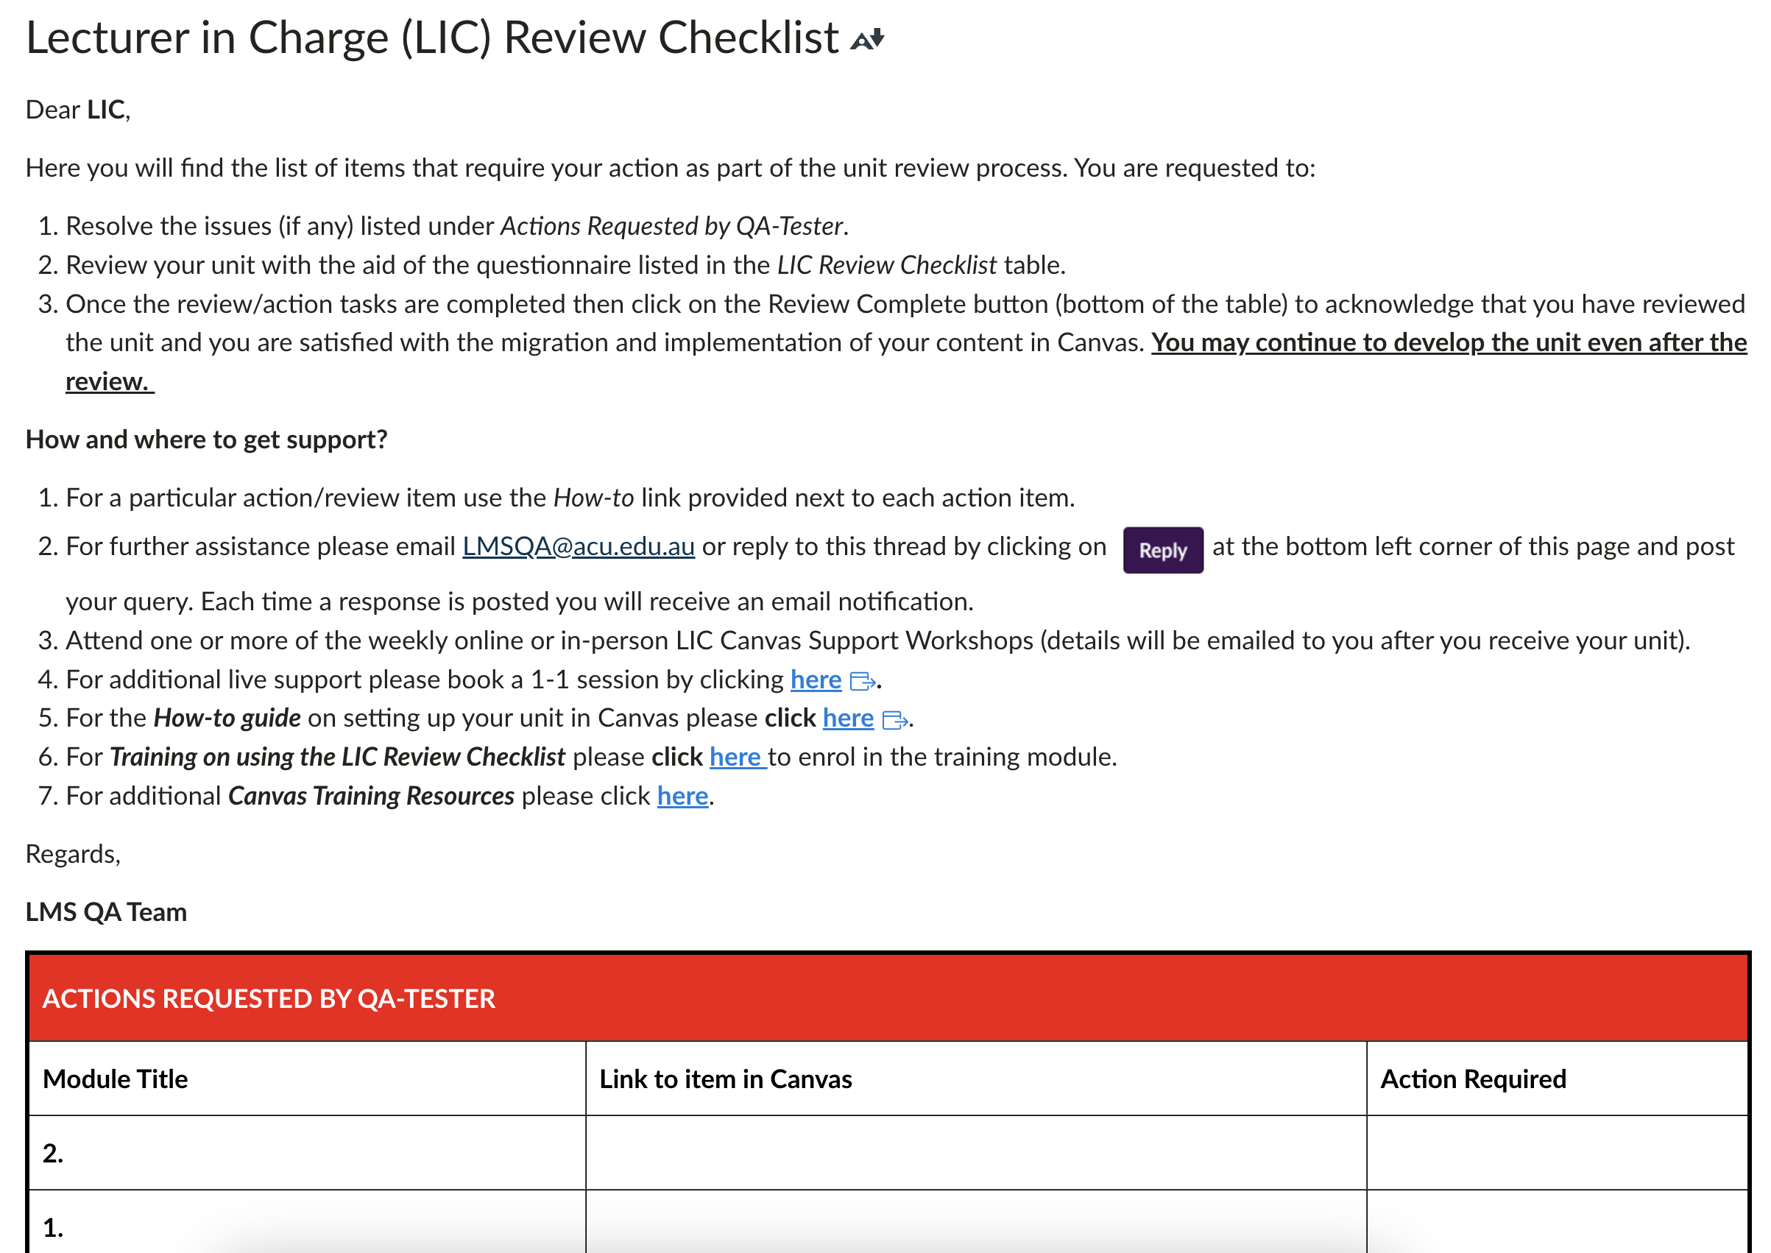
Receiving Your Migrated Unit: What to Expect (cont.)
Below are some screenshots of the LIC Checklist.
LIC Checklist: Instructions and Training & Support resources.
LIC Checklist: This is a checklist that the LIC will use to review the unit.

Slide 28
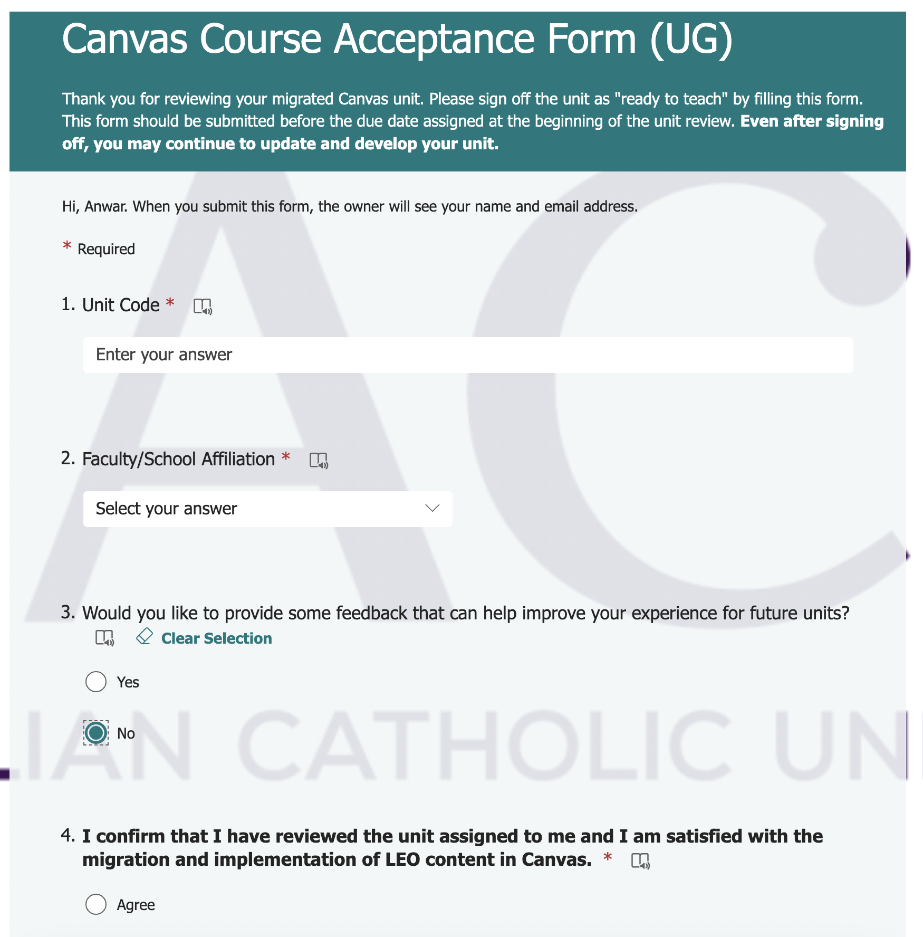
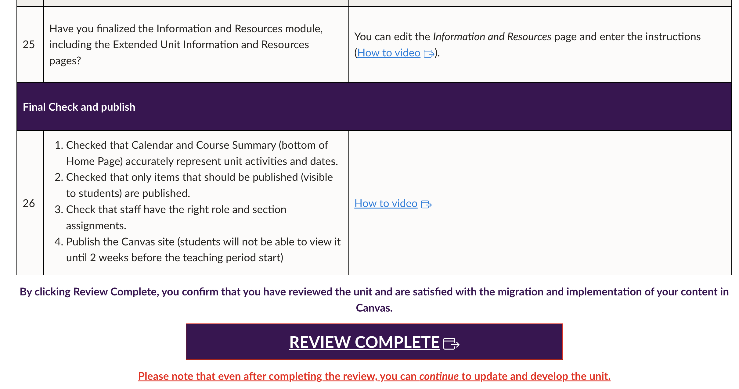
REVIEW COMPLETE
When you are happy that your unit is ready for you to progress to “Ready to Teach” you need to notify us, so we can move on to helping other LICs. This is done by simply clicking the link in your unit:
REVIEW COMPLETE link can be found at the bottom of the review checklist inside your Canvas Unit.
Acceptance form is filled out and submitted in order to complete the review.

Slide 29
4. Preparing

Slide 30

Preparing Your Unit: What You Need to Do
Once you have reviewed your unit, there are some simple steps you need to take to make your unit ready to teach:
Update the “Teaching Team” page of the unit
Update key dates in the unit (especially assessment dates)
Set up Announcements and Discussion Boards
Begin creating/updating content for a new teaching period
Notes:
Once the QA process and LIC checklist have been completed, a few final checks should happen before publishing the unit.

Slide 31

What is 'Ready to Teach?'
A unit is marked as ready to teach when:
LIC has completed all the required training.
LIC has reviewed the unit using the provided checklist.
All the teaching staff have been added to the unit.
The unit is ready and functional for students.
Notes:
The unit can be a work in progress with new content added or existing content updated as the semester progresses.

Slide 32
5. Teaching (in Canvas)

Slide 33
Teaching with Canvas
Once you have completed all the steps, you should be ready to teach with Canvas.
There will be ongoing support from the Project Team.
Canvas also provides 24/7 support and this is available through the Canvas Help Menu.

